Slide 1
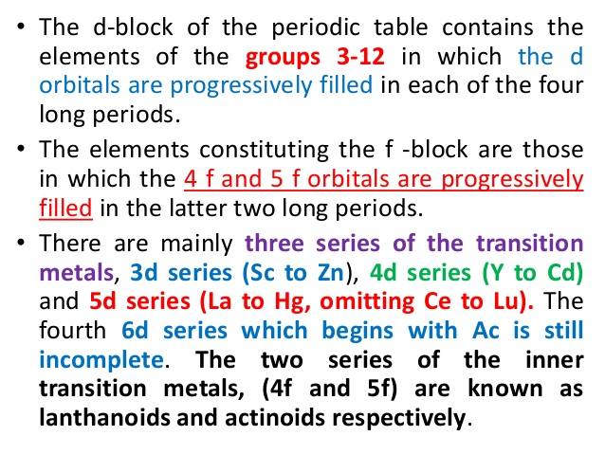
The d- and f-Block Elements

Slide 4
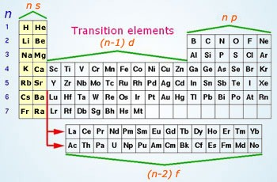

Slide 5
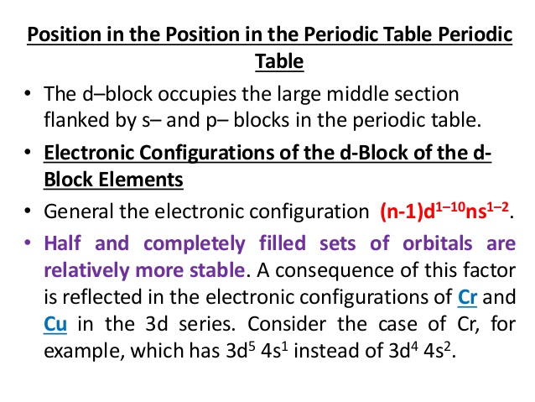

Slide 6
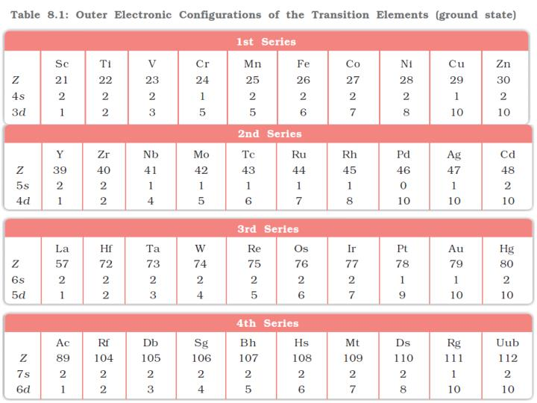

Slide 7
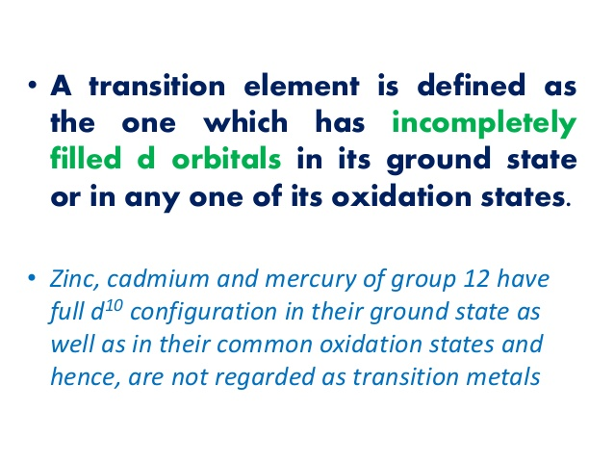

Slide 8
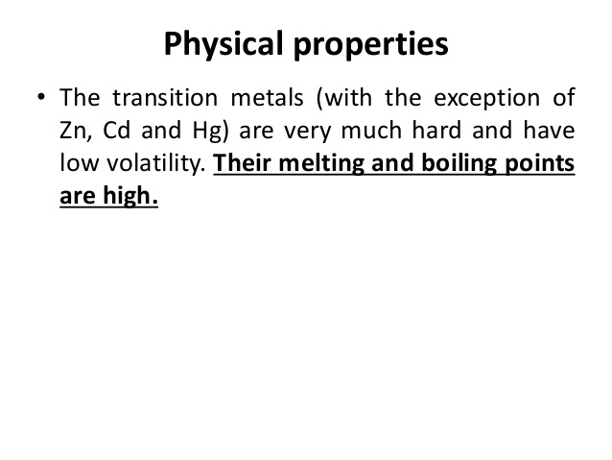

Slide 9
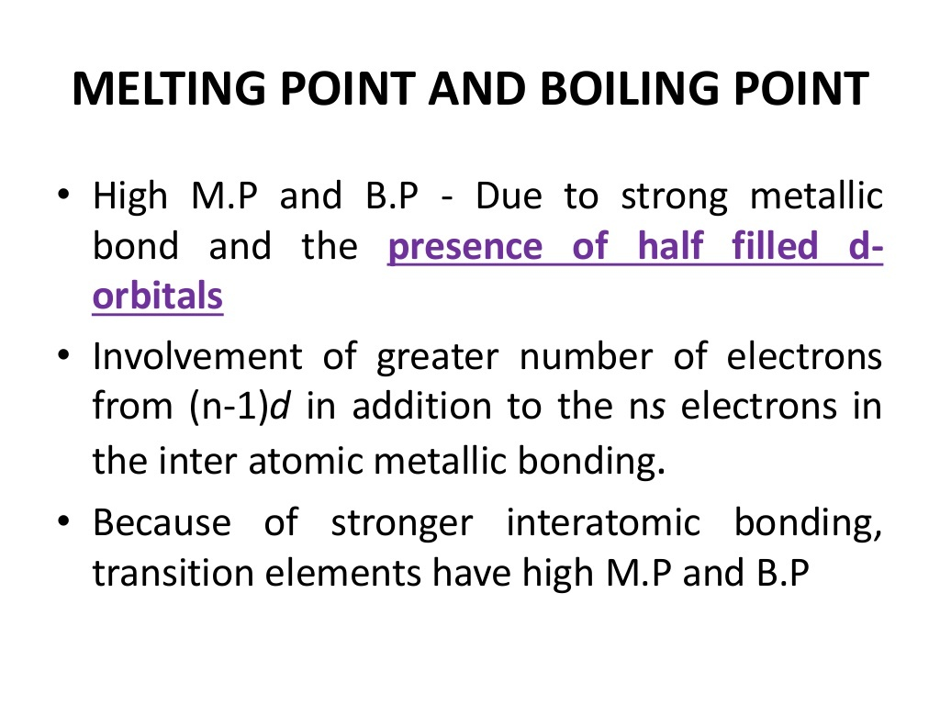

Slide 10
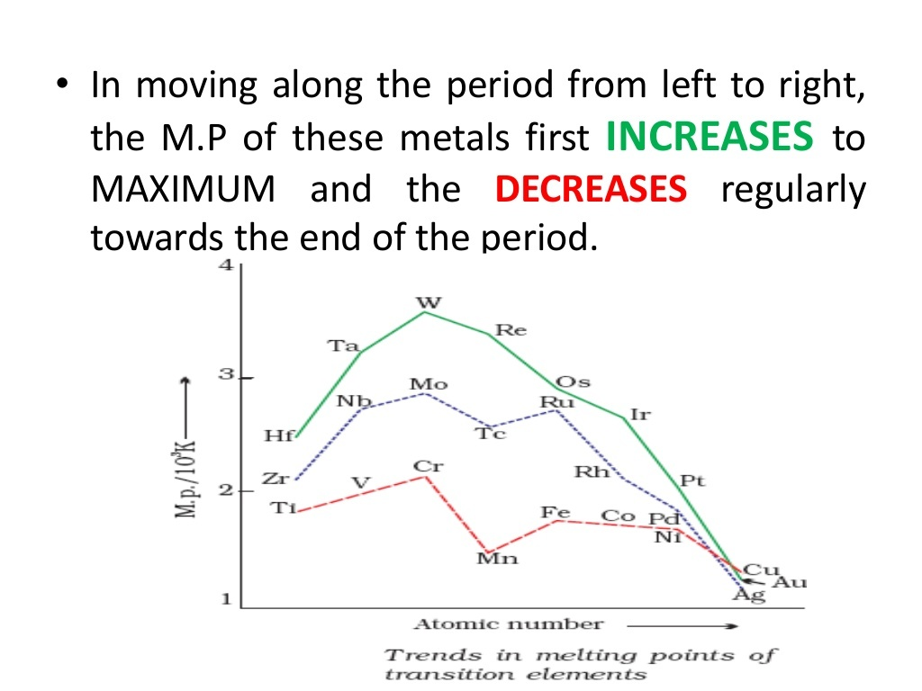

Slide 11
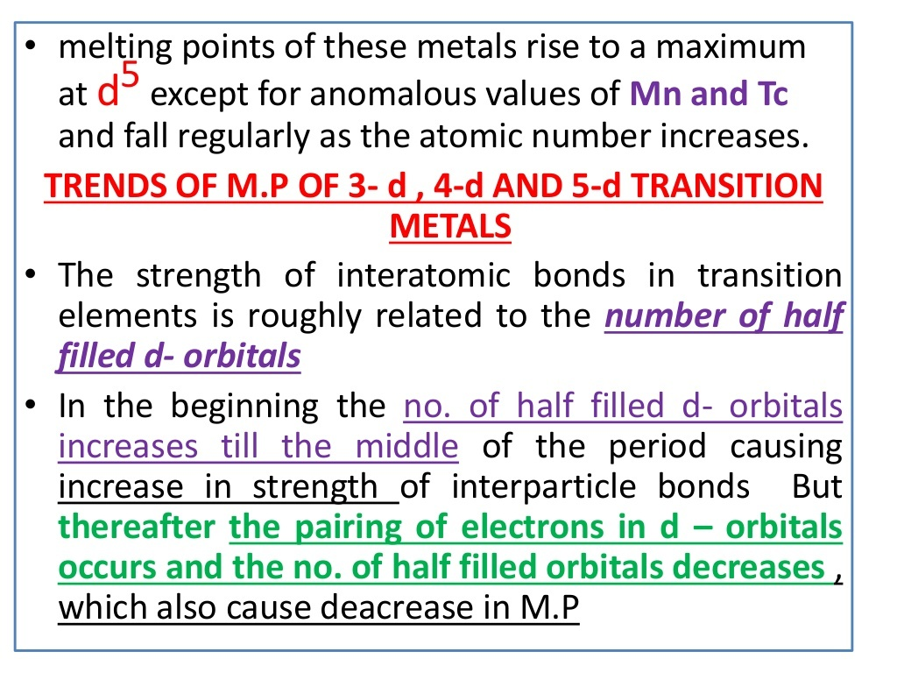

Slide 12
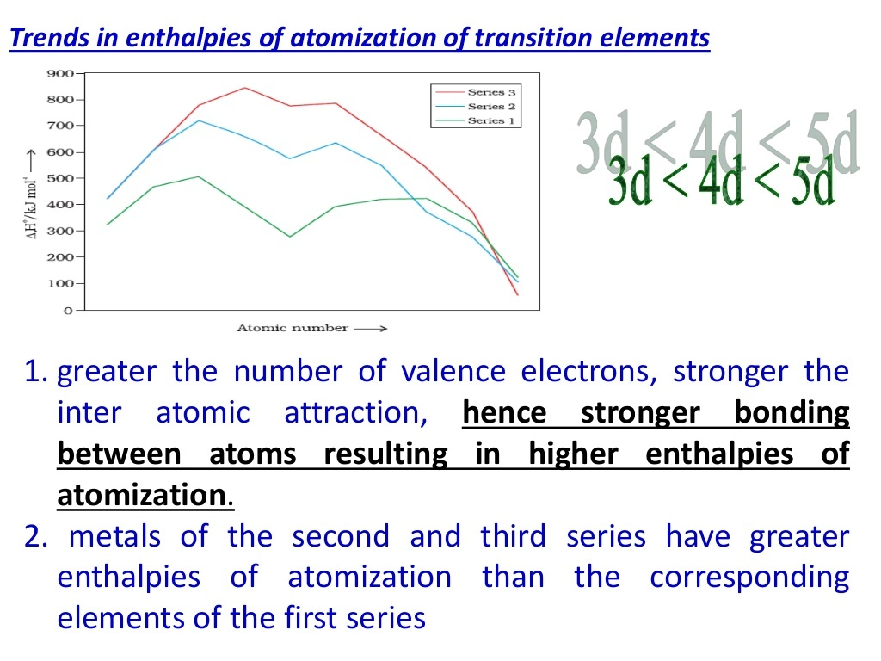

Slide 13
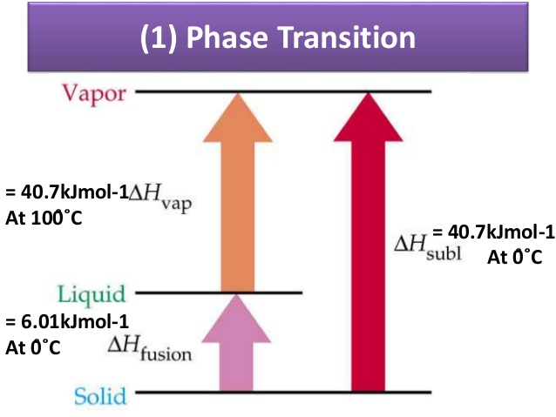
Enthalpy of Atomisation:
Enthalpy of atomisation, ΔaH0, is the change in enthalpy when one mole of bonds are completely broken to obtain atoms in the gas phase. For example: atomization of methane molecule.
CH4 (g) → C (g) + 4H (g) ΔaH0= 1665.0 kJ mol-1
For diatomic molecules, enthalpy of atomization is equal to the enthalpy of bond dissociation. For example: atomization of dihydrogen molecule.
H2 (g) → 2H (g); ΔaH0= 435.0 kJ mol-1
Greater the number of valence electrons stronger would be the resultant bonding. Higher the values of enthalpies of atomisation higher would be the BP

Slide 14
ATOMIC AND IONIC RADII
Governed by 2 factors
1. the electrostatic attraction between the positive nucleus and the electrons
2. the mutual repulsion of the electrons present in the size determining outer shell

Slide 16
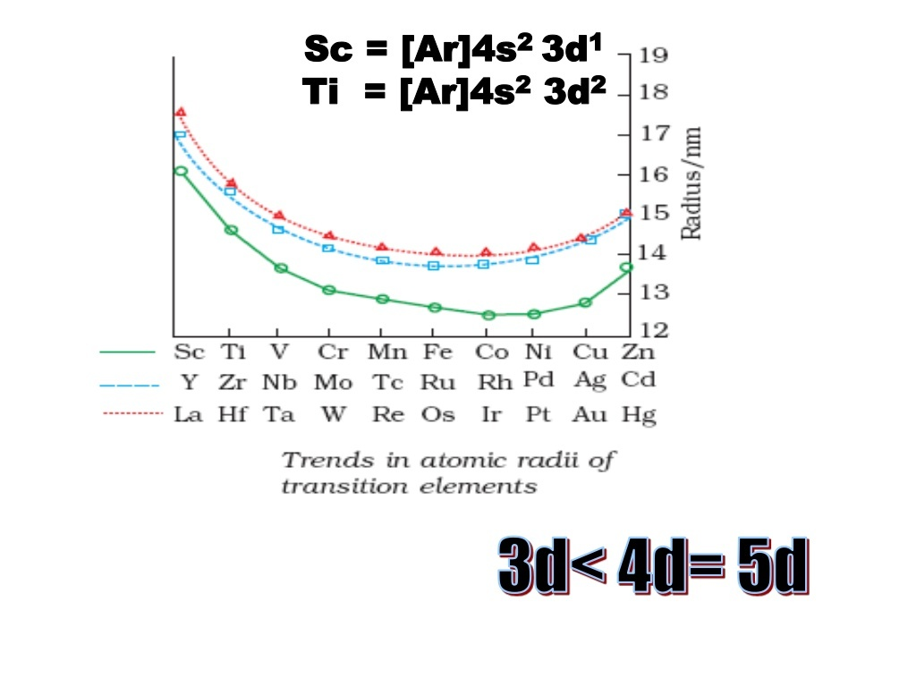

Slide 17
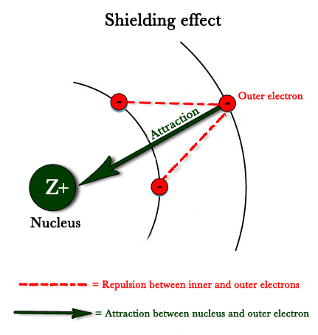
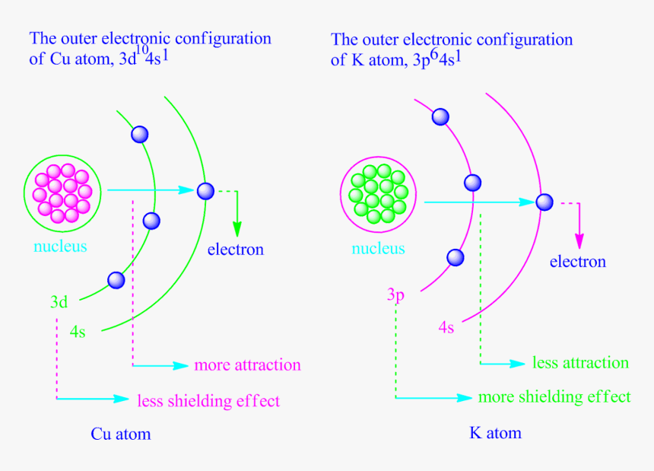
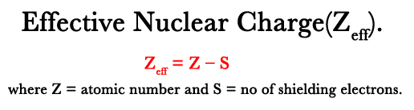

Slide 18
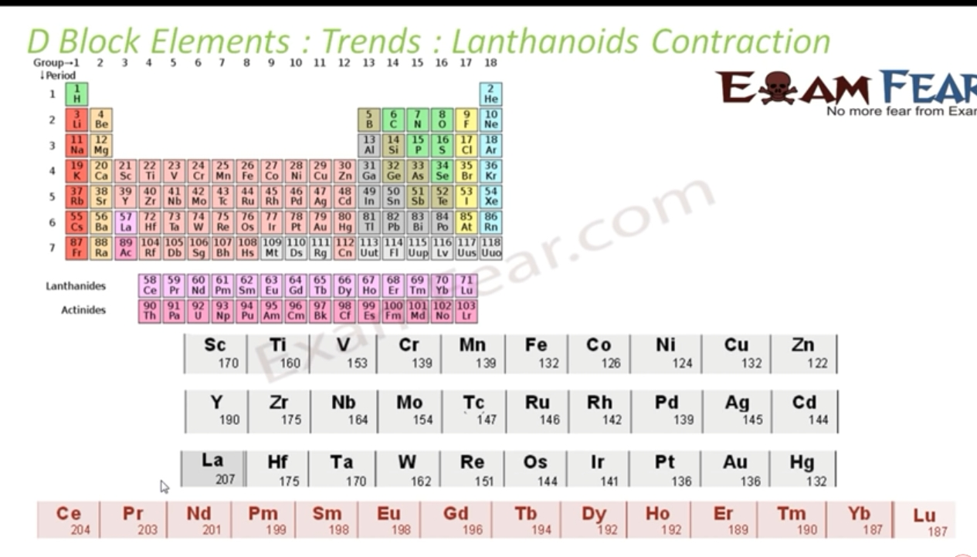

Slide 20
Lathanoid contraction
The filling of 4f before 5d orbitals results in a regular decrease in atomic radii called as lathanoid contraction.

Slide 21
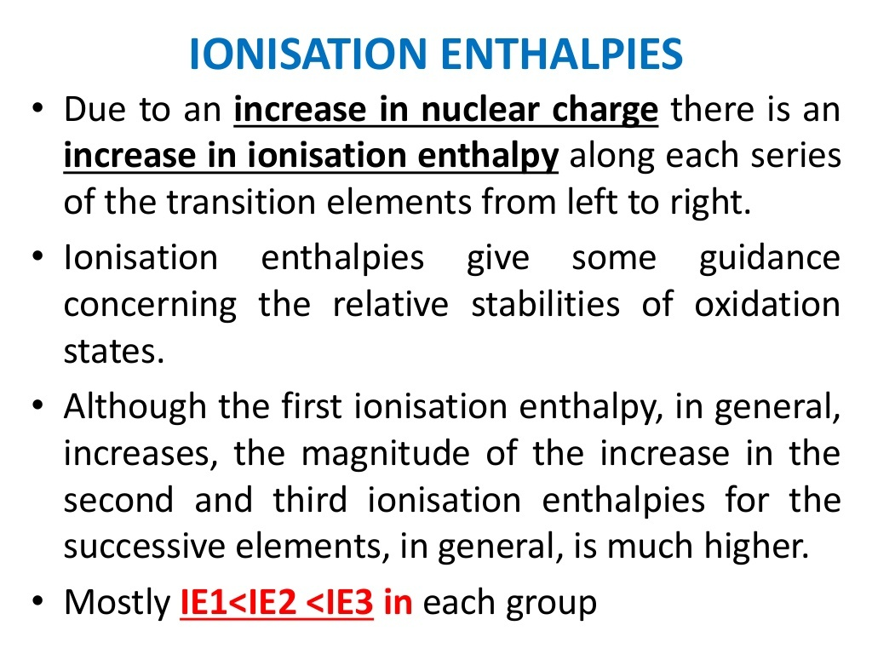

Slide 22
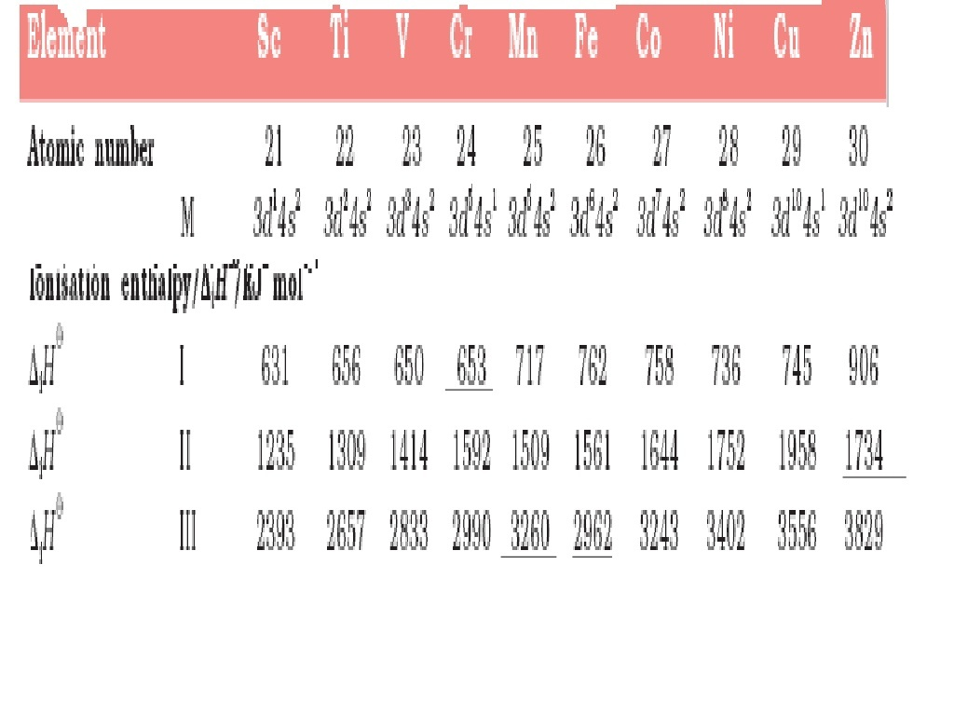

Slide 23
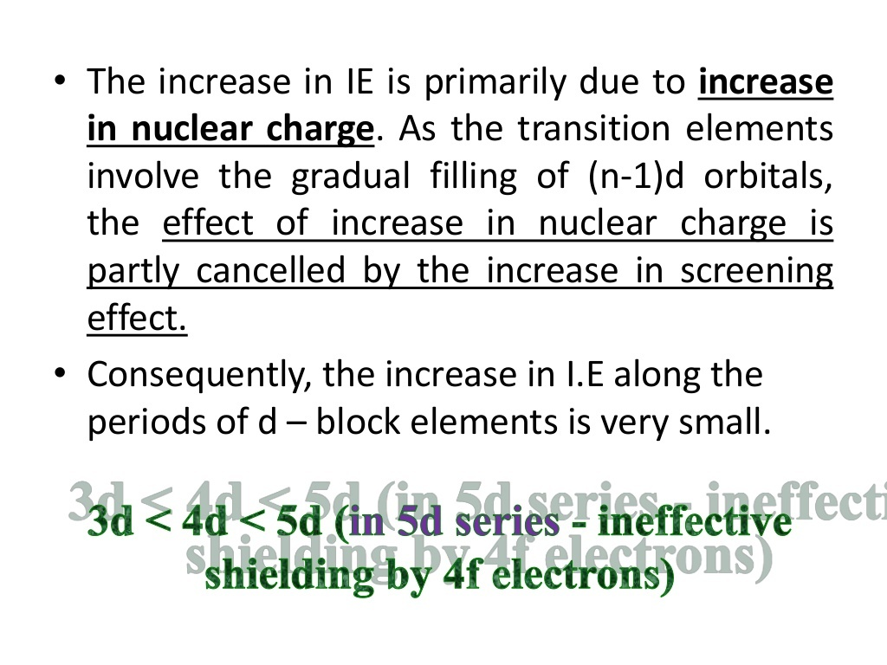

Slide 24
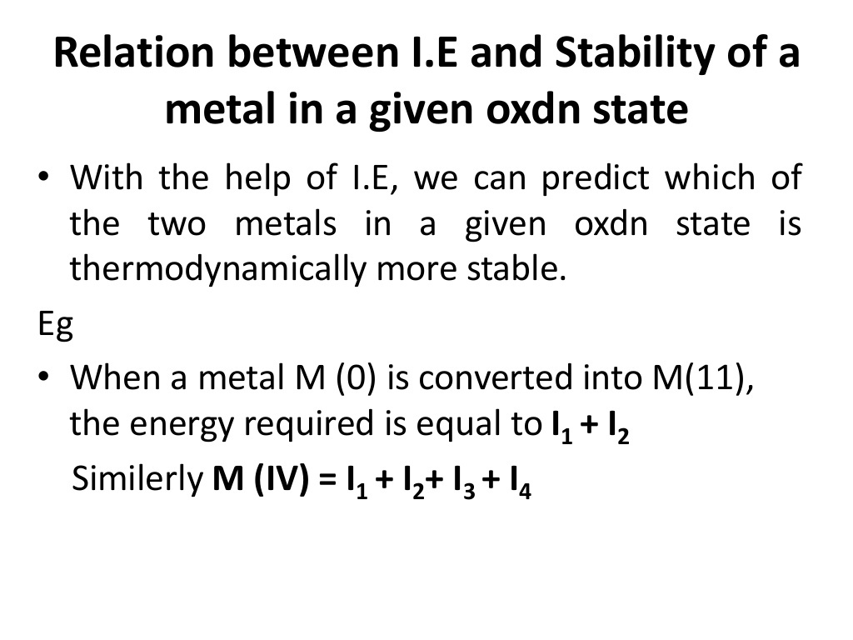

Slide 25
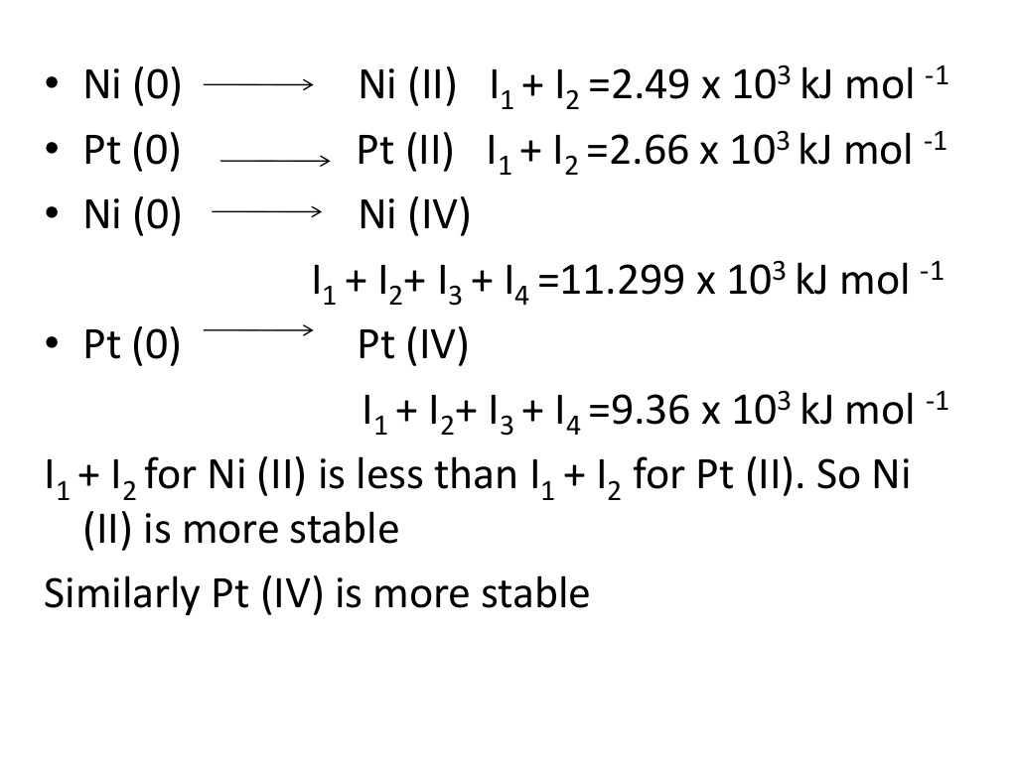

Slide 26
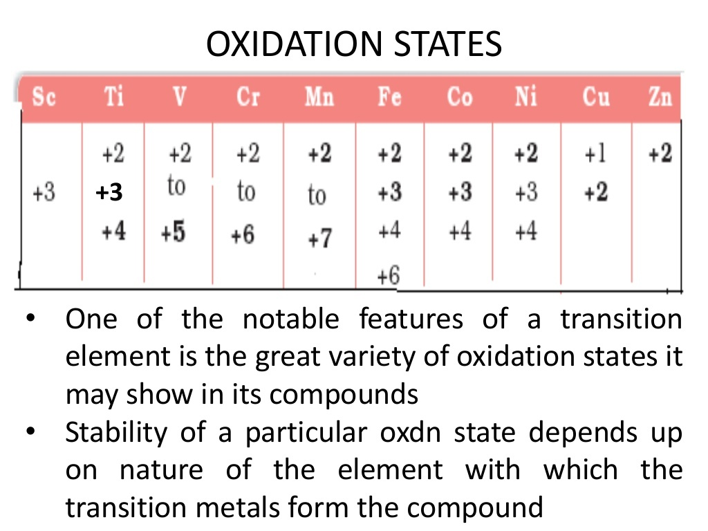

Slide 27
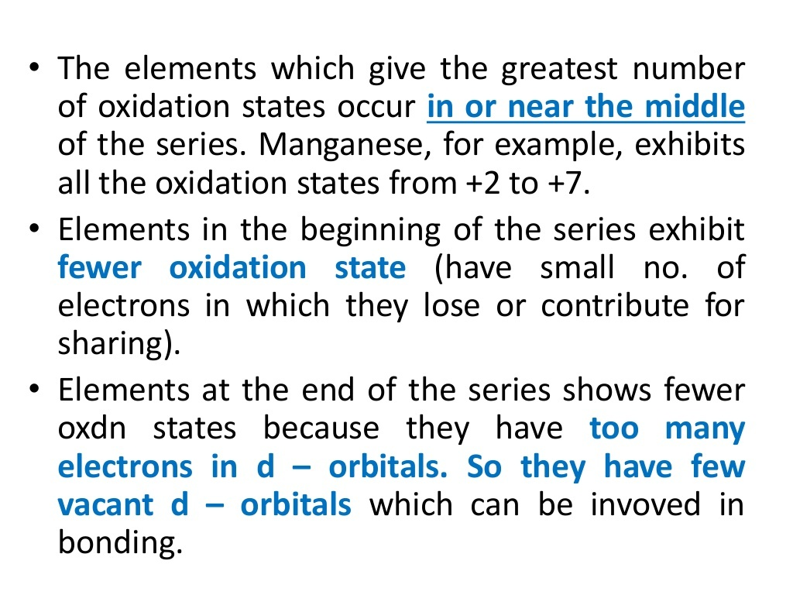

Slide 28
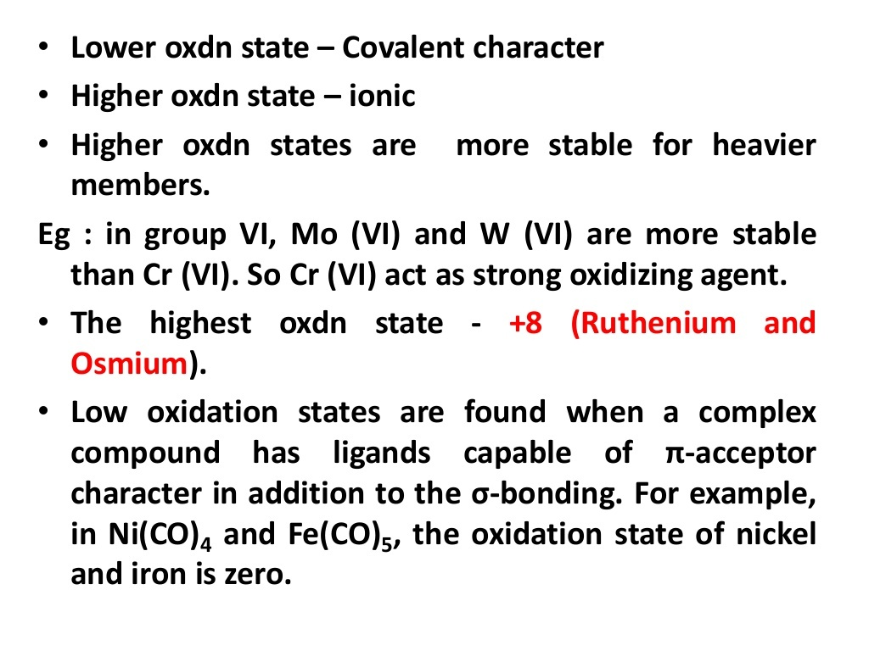

Slide 29
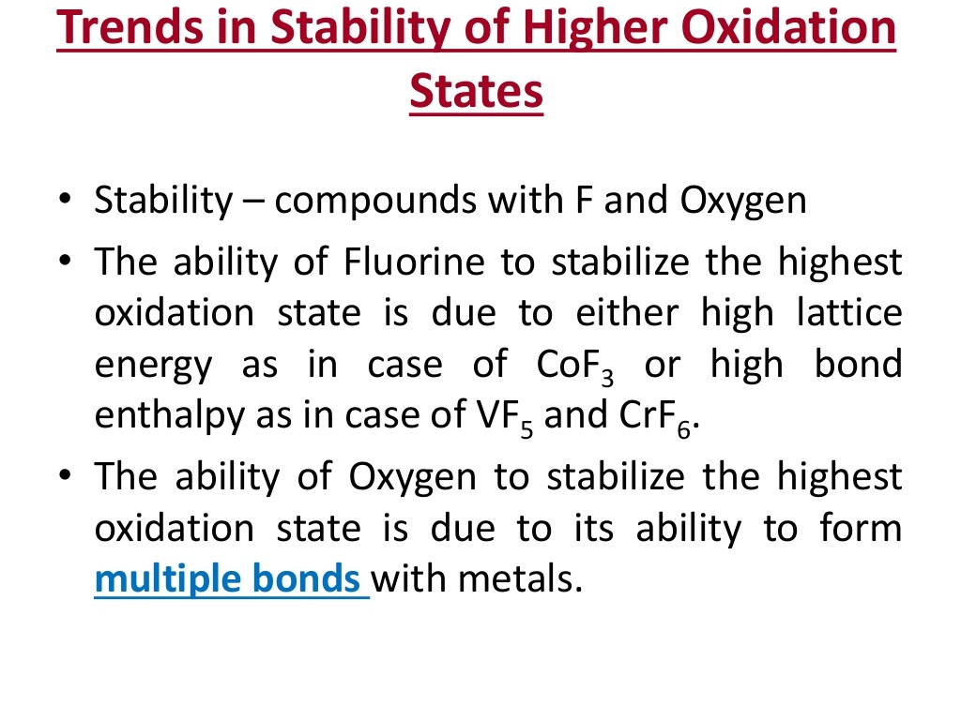

Slide 30
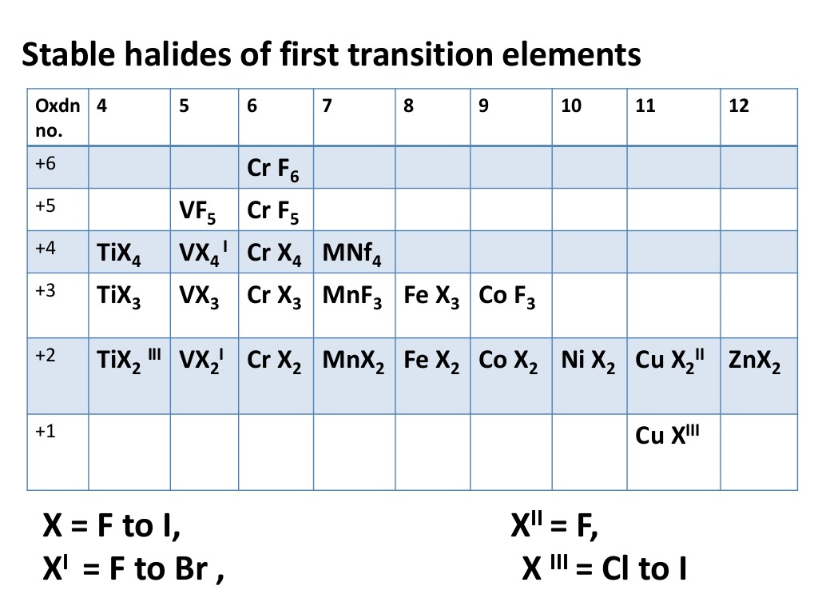

Slide 31
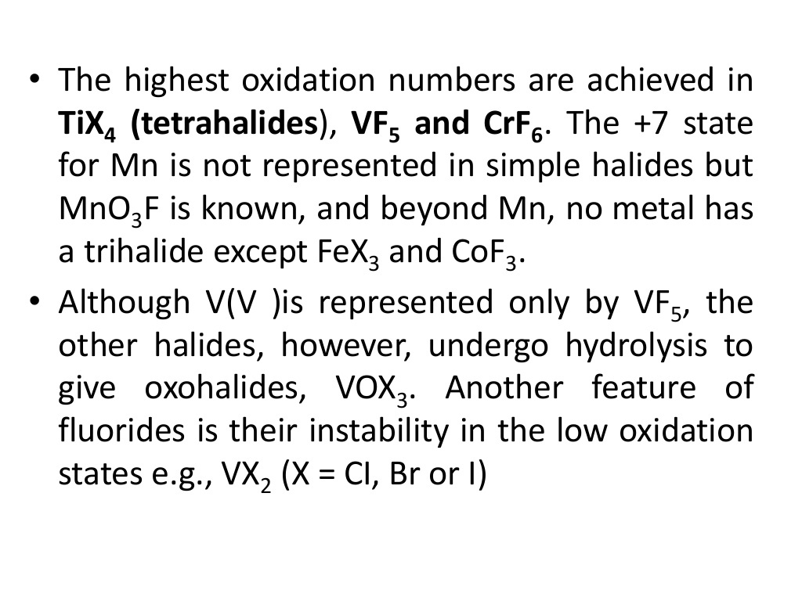

Slide 32
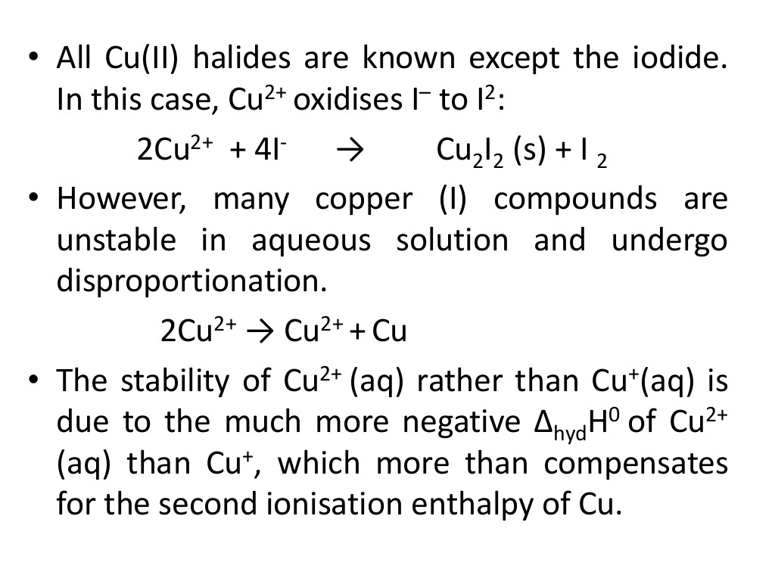

Slide 33
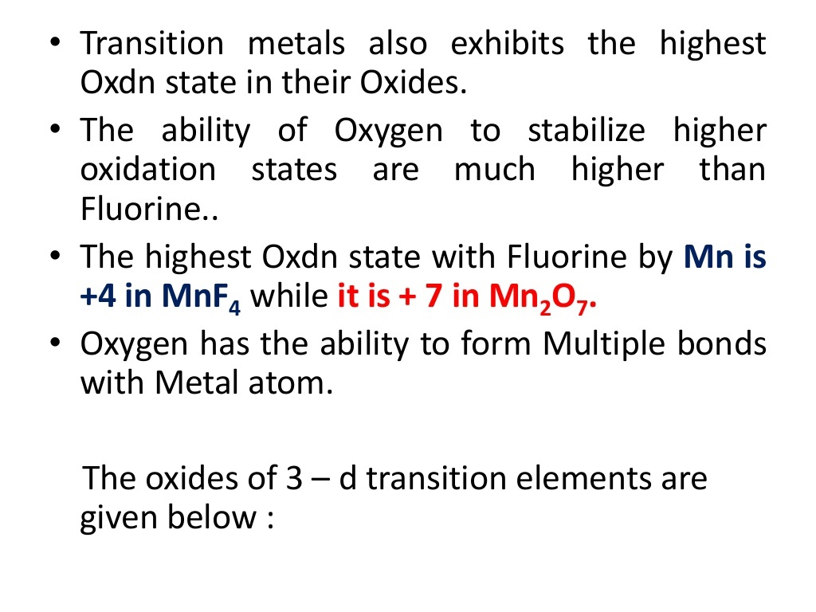

Slide 34
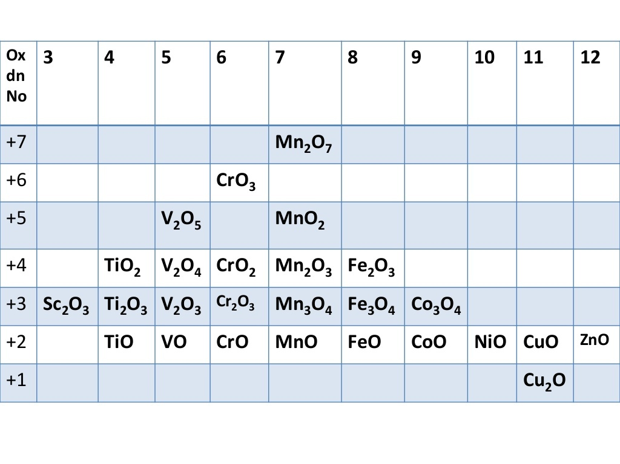

Slide 35
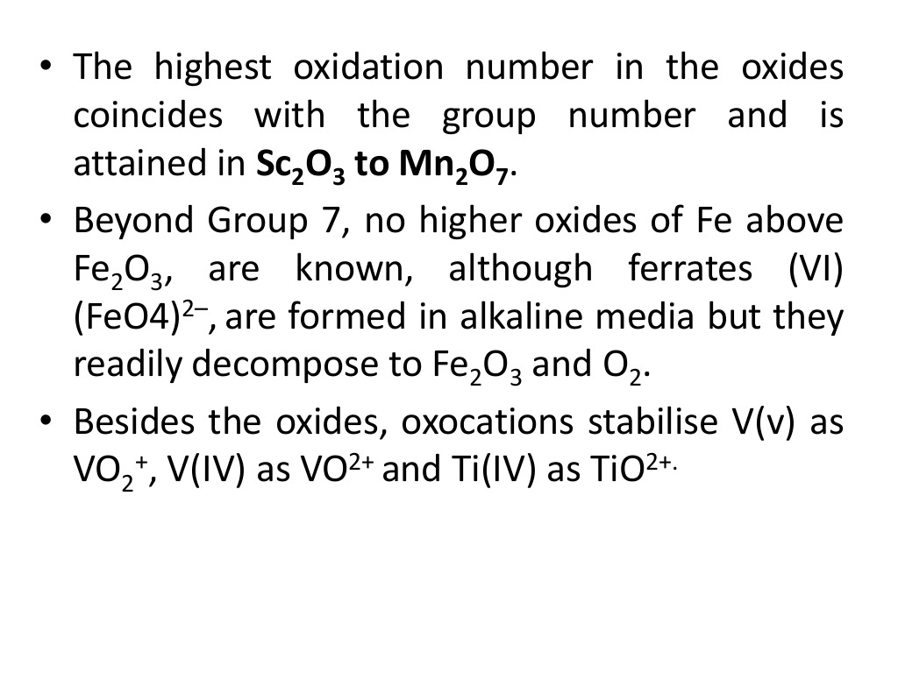

Slide 36
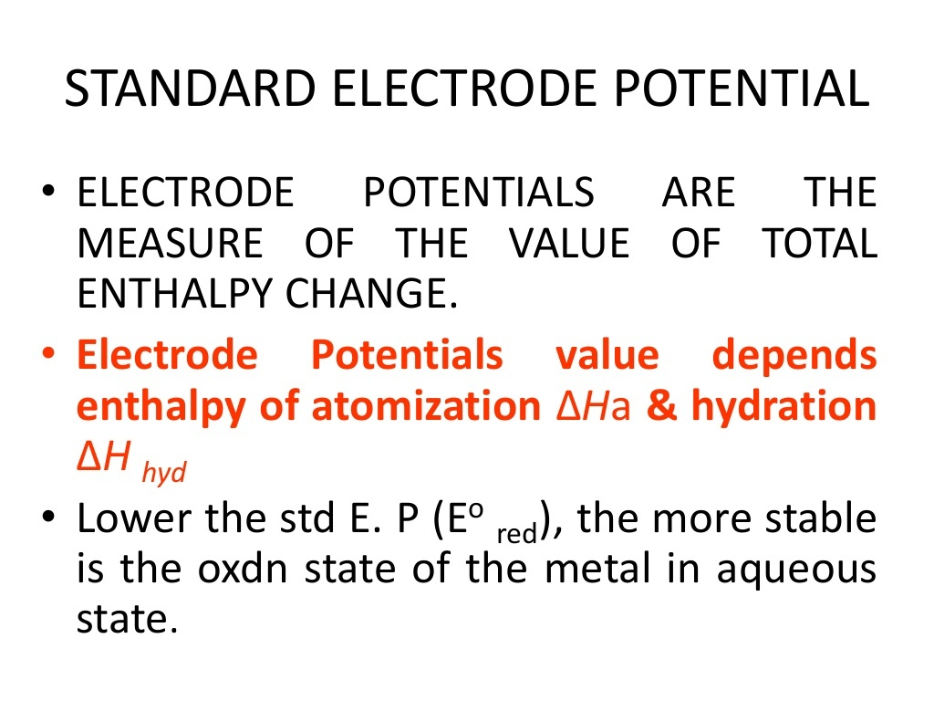

Slide 37
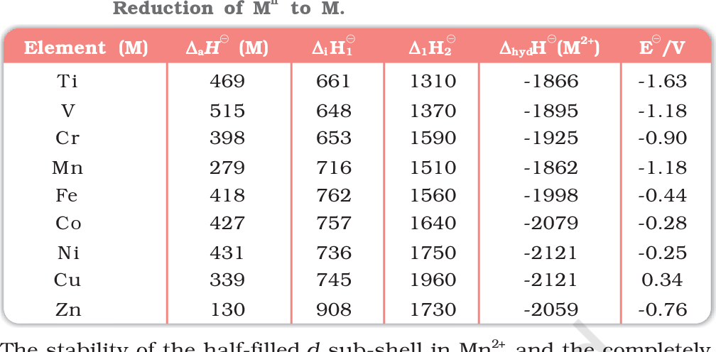

Slide 38
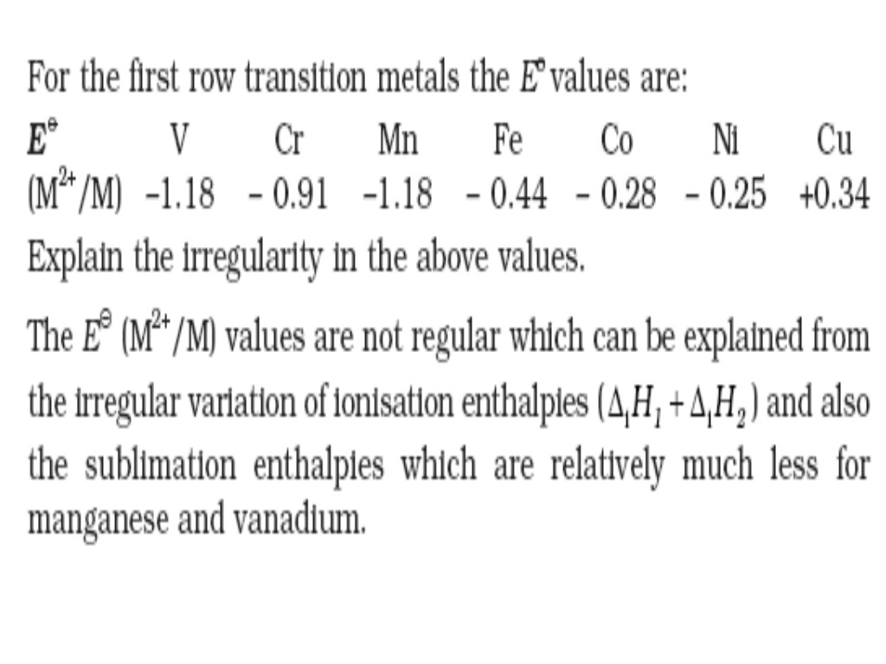

Slide 39
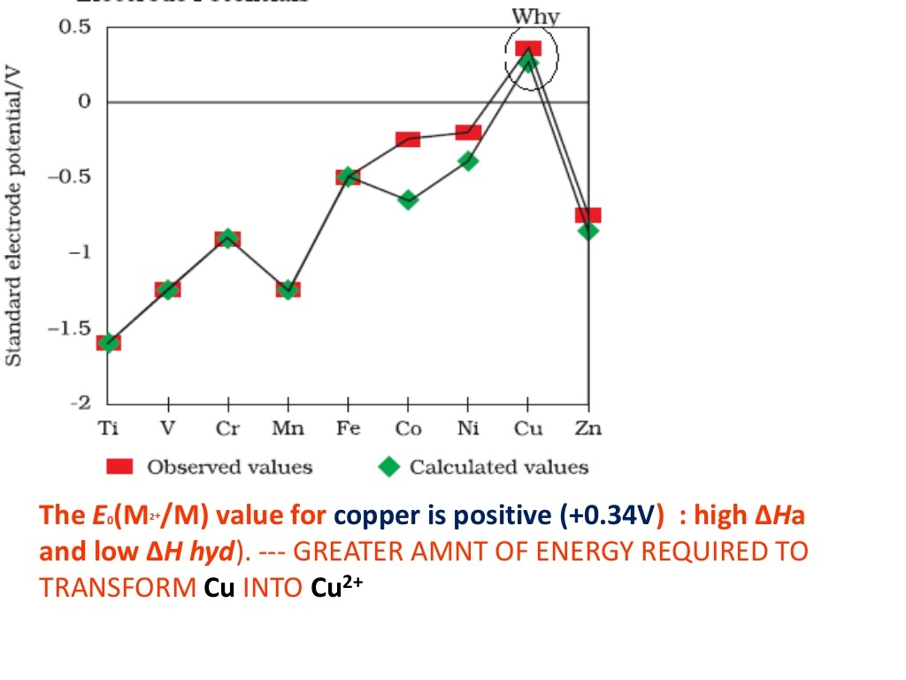

Slide 40
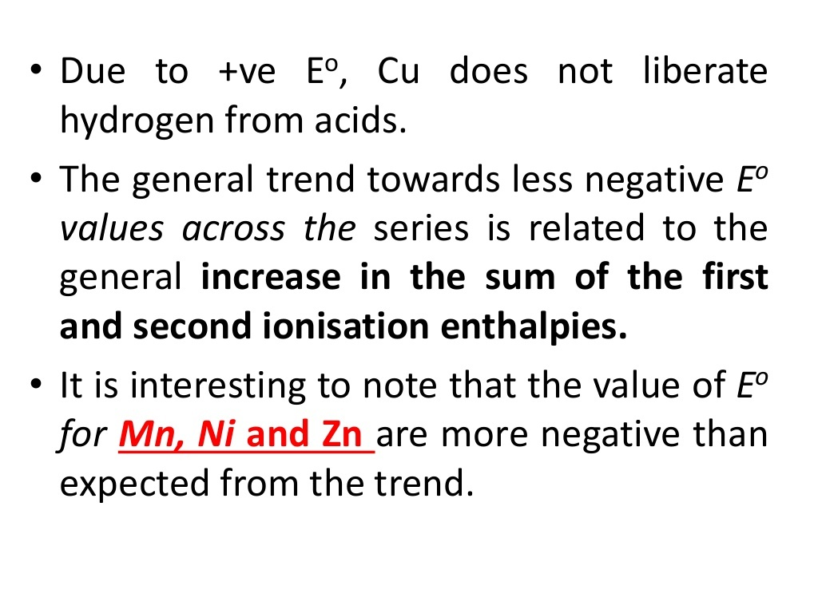

Slide 41
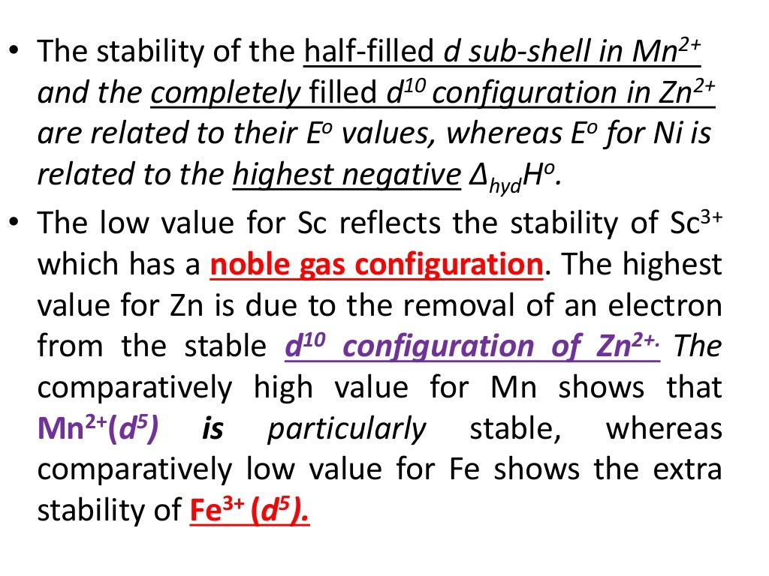

Slide 42
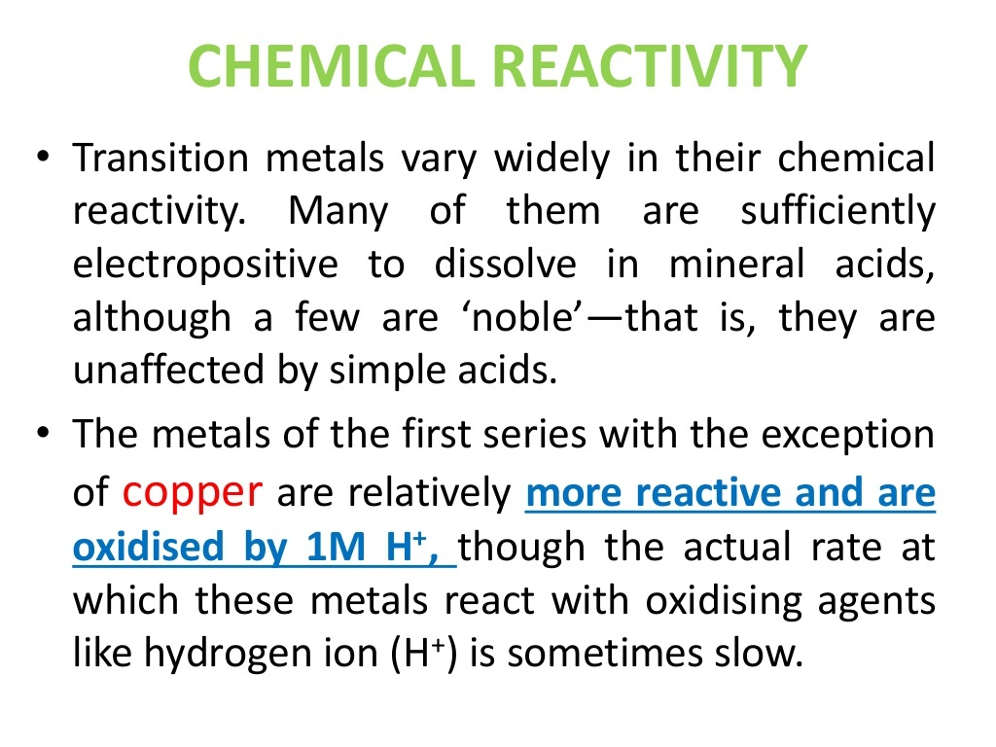

Slide 43
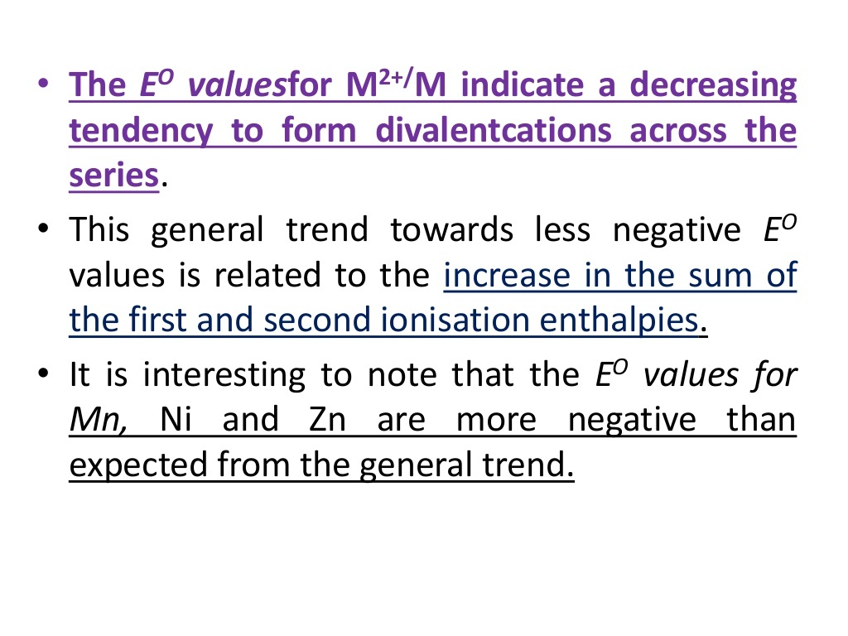

Slide 44
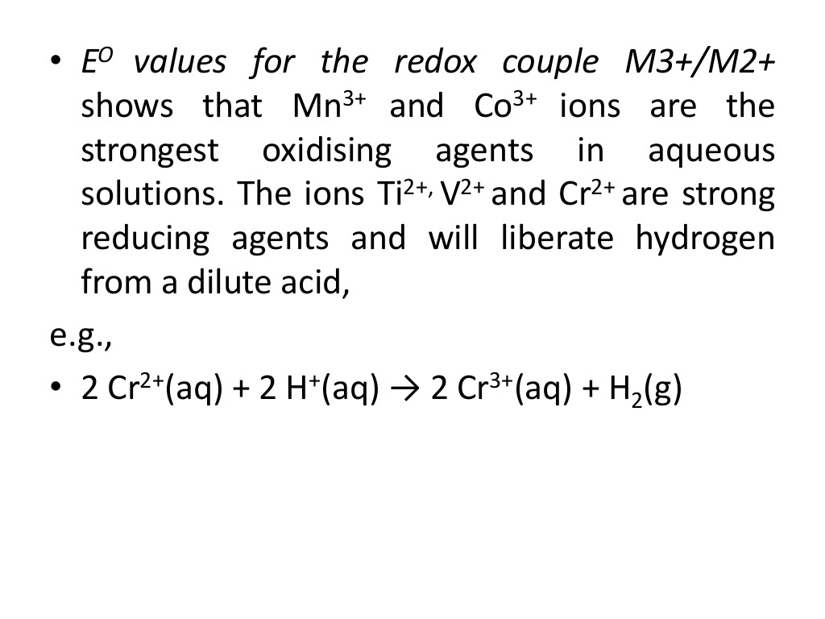

Slide 45
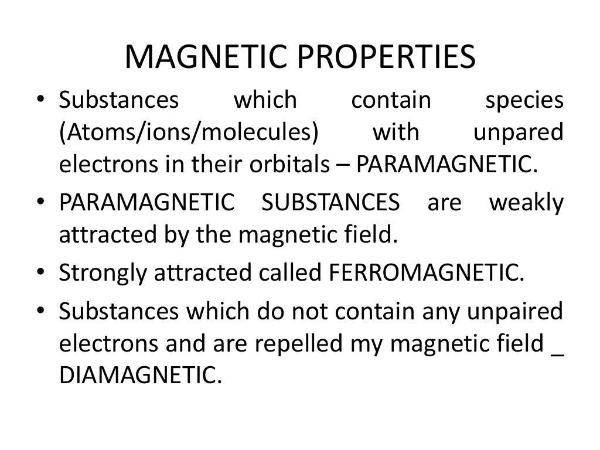

Slide 46
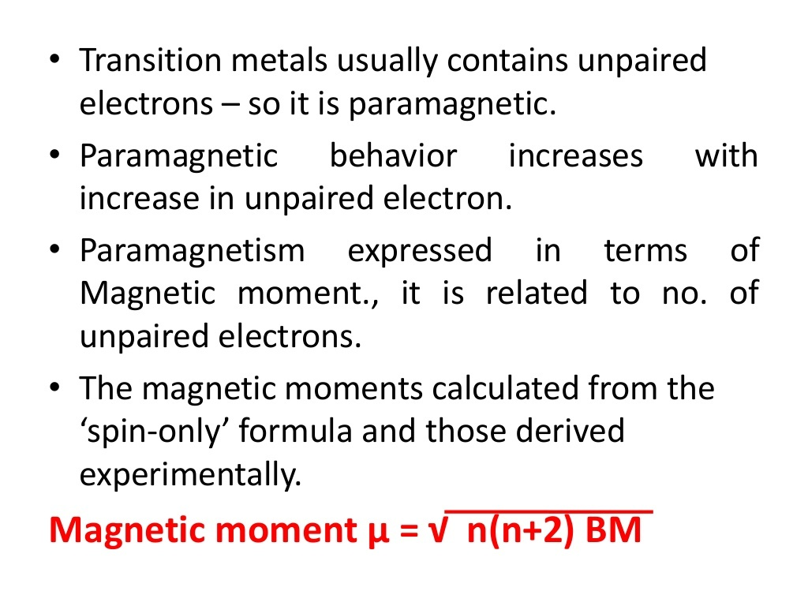

Slide 47
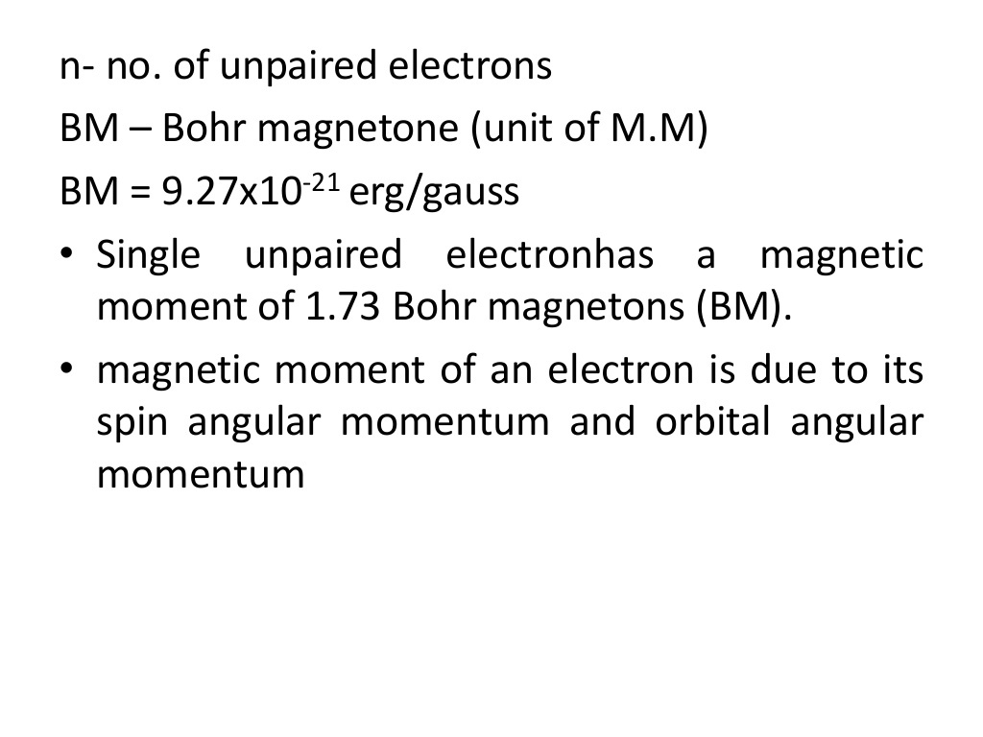

Slide 48
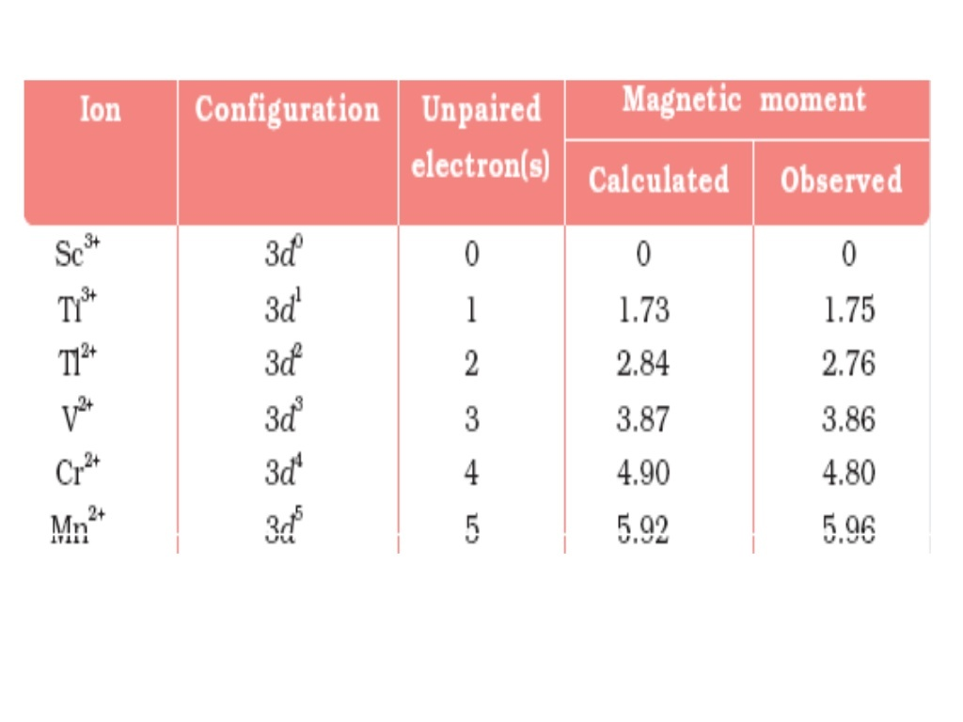

Slide 49
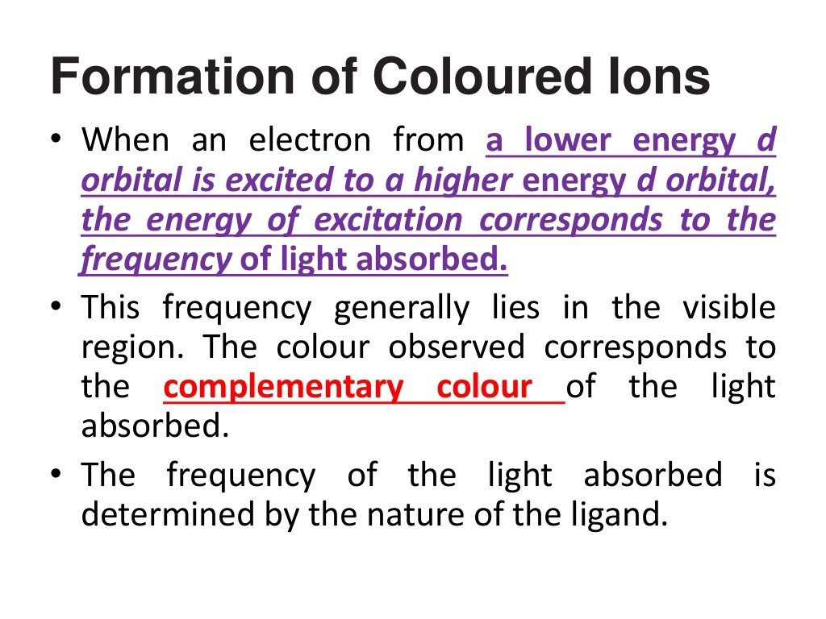

Slide 50
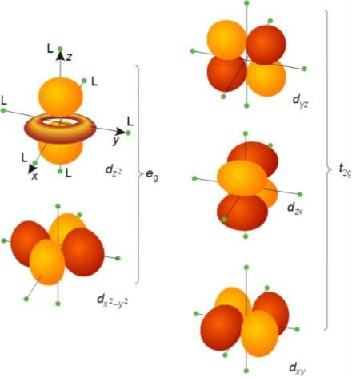
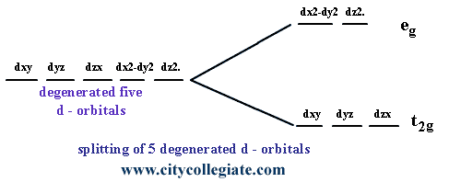
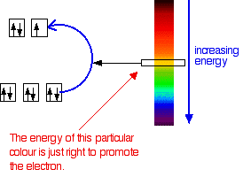

Slide 51
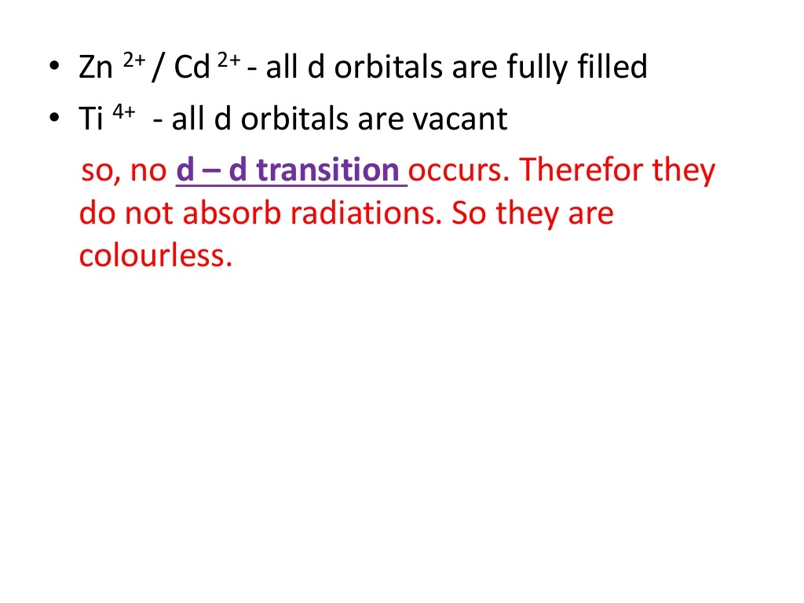
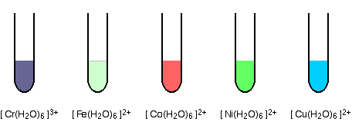


Slide 52



Slide 53


Slide 54


Slide 55


Slide 56


Slide 57


Slide 58


Slide 59


Slide 60


Slide 61


Slide 62


Slide 63


Slide 64


Slide 65


Slide 66


Slide 67


Slide 68


Slide 69


Slide 70


Slide 71


Slide 72


Slide 73


Slide 74


Slide 75


Slide 76


Slide 77


Slide 78


Slide 79


Slide 80


Slide 81


Slide 82


Slide 83


Slide 84


Slide 85


Slide 86


Slide 87


Slide 88


Slide 89


